Slide 1
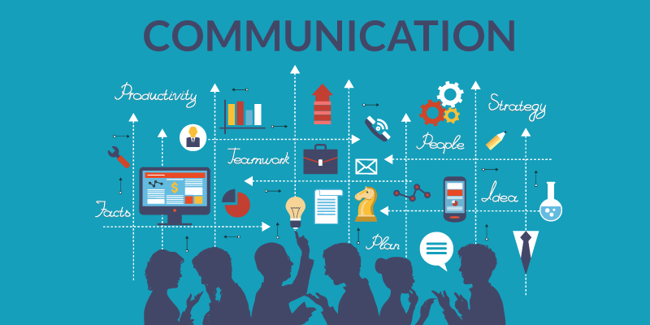

Slide 2

INTRODUCTION
Communication is effective when messages are passed across successfully
Messages can be passed both in the formal, informal or personal context
Notes:
Communication is the lifeline of any situation

Slide 3

DEFINITION
It is a two way process, where there is an exchange and progression of thoughts, feelings or ideas

Slide 4
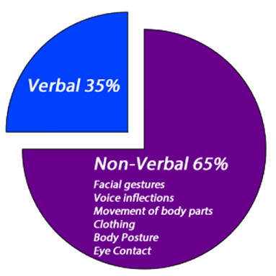
TYPES OF COMMUNICATION
Verbal
Non verbal
http://formatcomunicacion.com/VerbalAndNonverbal/

Slide 5

VERBAL COMMUNICATION
This is what we say and how we say it
Notes:
It can be a face-to-face discussion
It can be through telephone conversation, radio, television

Slide 6

NON-VERBAL COMMUNICATION
This is through our actions
Things we do without speaking e.g. writing and posters
Notes:
This is through our actions i.e.
Visual e.g. facial expressions, postures and body gestures
Silence
Tactile e.g. hug, touch
Smell e.g. body odor
Things we do without speaking e.g. writing and posters

Slide 7


Slide 8
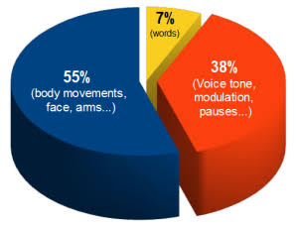
COMMUNICATION PARTS
http://www.maximumadvantage.com/demonstration-of-non-verbal-communication.html

Slide 9
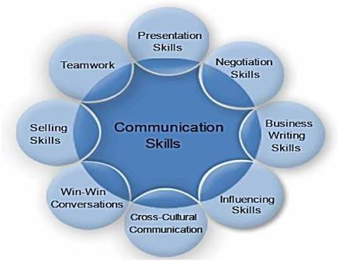
COMMUNICATION SKILLS
Listening
Observing
Speaking
Questioning
Analysing
Evaluation
Notes:
Listening: Being a good listener is one of the best ways to be a good communicator. No one likes communicating with someone who only cares about putting in her two cents and does not take the time to listen to the other person. If you're not a good listener, it's going to be hard to comprehend what you're being asked to do
Observing: Do not been to quick to answer, take time to watch your client closely, you might just pick up something useful from his/her words and actions
Speaking: Respond to your client to show that you are listening to them and that you understand what they are saying. Being able to appropriately give and receive feedback is an important communication skill
Questioning: Ask questions for clarifications if you do not understand your client
Analysing
Evaluation

Slide 10
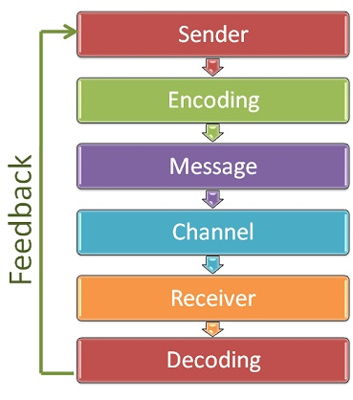
ELEMENTS OF COMMUNICATION PROCESS
Notes:
Who is communicating?
What has to be communicated?
Why it has to be communicated?
When it has to be communicated?
Who it has to be communicated to?
How it has to be communicated?

Slide 11

WAYS OF COMMUNICATION
Positive ways of communicating
Negative ways of communicating

Slide 12


POSITIVE WAYS OF COMMUNICATING
Warm Smile
Courteous and friendly
Maintain eye contact
Show genuine concern
Active listening, avoid interrupting or preempting clients

Slide 13

Address client by name using appropriate title e.g. Dr., Chief.
Avoid abbreviations
The use of appreciative words

Slide 14
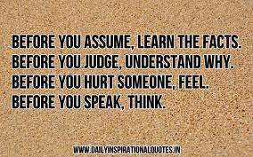

Speak in a clear low tone of voice
Treat all clients equally
Confidentiality
Ask for clarifications, do not assume
Prompt return of telephone calls

Slide 15


NEGATIVE WAYS OF
COMMUNICATING
Little or no eye contact
Unpleasant disposition
Addressing clients wrongly
Untidy or inappropriate dressing
Not acknowledging the person
in front of you
Attacking the person and not the problem
Notes:
Asking confidential questions in public
Giving little or no information

Slide 16
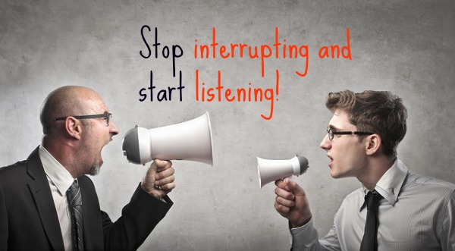


Interrupting conversations
Asking challenging questions
Dishonest or wrong information
Poor email etiquette
When calls are not returned
Notes:
Reacting to situation
Aggressive and unfriendly
Rude

Slide 17
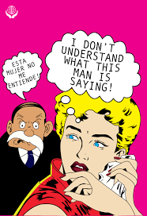

FACTORS THAT CAN AFFECT COMMUNICATION
Language barrier
Poor disposition
Lack of focus e.g. personal bias
Lack of trust
Notes:
Environmental factors e.g. noise, room temperature
Lack of knowledge

Slide 18


Past experience
Tone of voice
Bad attitude
Notes:
Culture
Ambiguity
Information overload
Assumptions and jumping to conclusions

Slide 19

COMMUNICATION TECHNIQUES
Effective or Therapeutic
Non-effective or Non-therapeutic

Slide 20
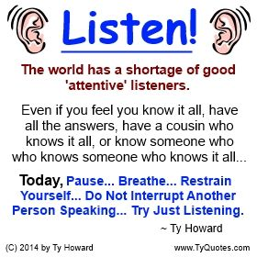
EFFECTIVE COMMUNICATION
Listening
Maintaining silence
Maintaining neutral response

Slide 21
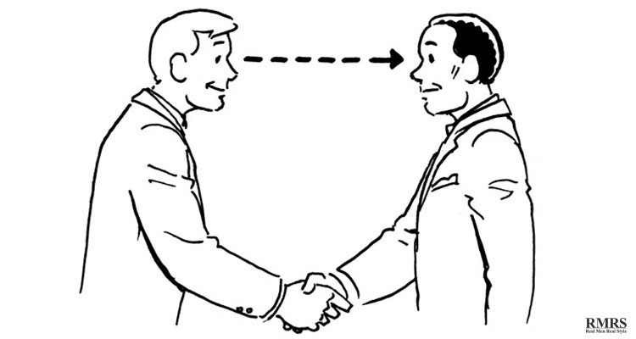
EFFECTIVE COMMUNICATION
Restating
Maintaining eye contact
The use of open-ended questions

Slide 22
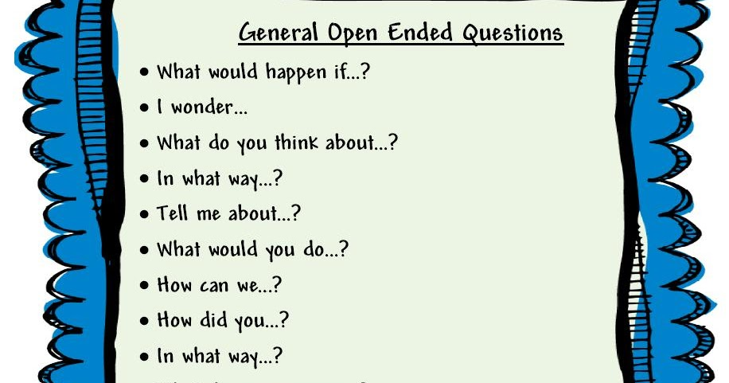

Slide 23
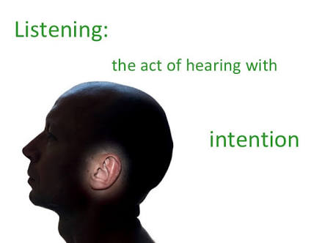
THE ACT OF LISTENING
Listening helps an individual:
Gain new understanding of a situation
Become a better learner
Learn to respect that everyone has his/her reality and truth
Notes:
Solve problems for himself and others
Create authentic connection and build trust

Slide 24
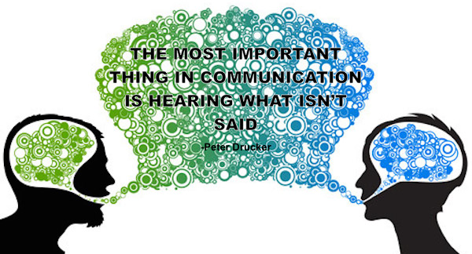
To be a good listener
Be present and give 100% attention using all senses – ears, eyes, heart and intuition
Be patient, impartial and open minded
Take note of body languages
Notes:
Be aware of the verbal and non-verbal messages in what is being said
Ask clarifying and engaging questions to show interest in the conversation

Slide 25
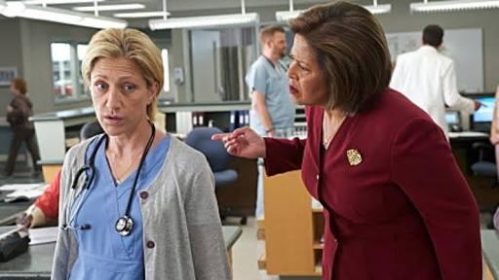
NON-EFFECTIVE COMMUNICATION
Asking for explanation, using the word ‘’Why’’
Providing false reassurance e.g. ‘’Don’t worry’’
Giving advice , approval or disapproval
Changing the subject
Defensive behaviour
Notes:
Using terms of endearment such as ”honey”
Talking about your personal experience(s) or challenges
Challenging the client to define a position / feeling / decision

Slide 26

MAGIC WORDS
Good morning
Please
Excuse me
Sorry
Thank you
Pardon me

Slide 27

TIPS FOR PROPER TELEPHONE ETIQUETTE
Know how the telephone functions
Have pen and paper readily available to take messages
Pick up the receiver before the third ring
Speak in a low tone of voice
Smile when receiving calls , this helps with the tone of voice

Slide 28
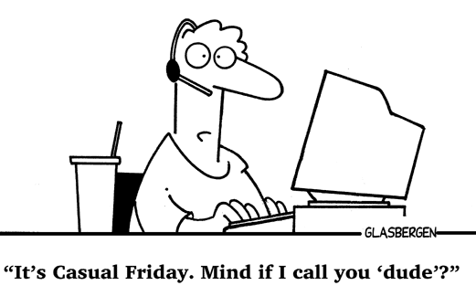
Greet caller first, introduce organisation or department and then yourself e.g. ‘’Good morning ChrisGloria Management Services, Tayo on the line. How may I help you, please?’’
If the line goes off before the end of a conversation, call back immediately and apologise
Be polite and friendly
Deliver messages promptly

Slide 29

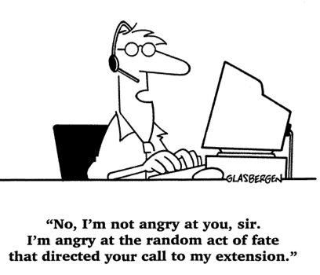
If a call must be transferred, explain politely to the caller. Give the name of the person the call is being transferred to
Take accurate messages and repeat to reaffirm
Be patient and tolerant
At the end of conversations, the caller should be given the opportunity to hang up first

Slide 30



Slide 31
QUOTES
“Having the right words to say is important, but not more important than saying the right words the right way. And both are not as important as communicating with the right non-verbal communication skills’’. Bern Wheeler
“Communication – the human connection – is the key to personal and career success”. Paul J. Meyer

Slide 32
QUOTES
“We have two ears and one mouth, so that we can listen twice as much as we speak”. Epictetus
“The most important thing in communication is hearing what is not said”. Peter Drucker
“To effectively communicate, we must realise that we are all different in the way we perceive the world and use this understanding as a guide to our communication with others”. Tony Robbins

Slide 33
CONCLUSION
The ability to communicate effectively with superiors, colleagues, and clients is essential.
The best way to communicate and understand clients is by really listening to them, this provides a platform for constructive feedbacks

Slide 34
